Slide 1


How does SQL Server store that data type?
Randolph West
SENIOR CONTENT DEVELOPER
MICROSOFT DOCS

Slide 2
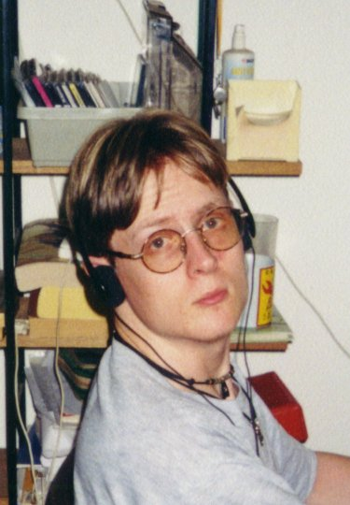

About Randolph West
Nerd
Come and talk to me about Microsoft Docs,
so I can tell my boss I spoke to customers
Please provide session feedback
https://evals.datagrillen.com/

Slide 3
ASK ME A GOOD QUESTION
TO WIN A COPY OF MY BOOK!
Please provide session feedback
https://evals.datagrillen.com/

Slide 4
The basics of binary (1/2)
A CPU is a hot mess of on-off switches (1s and 0s, bits)
There are 8 bits in a byte, but only by convention
Data is copied from storage into memory as-is
Data is copied from memory to the CPU registers as-is

Slide 5
The basics of binary (2/2)
It’s all binary, all the time
Binary is unwieldy for humans to read and write
170 in decimal is the same as 10101010 in binary
10101010 in binary is the same as 0xAA in hexadecimal
But …

Slide 6
Which end of the egg do you crack open?
Big endian vs little endian
x86-x64 uses little endian (“byte-reversed”)
ARM does both, but Windows chooses little endian
We’re bad at naming things
Notes:
In little endian, higher-order bits in memory are the most significant. In other words, the bytes are “flipped” or reversed.

Slide 7

Little endian explained for the 21st century
Is it worth it, let me work it
I put my thing down, flip it and reverse it
I put my thing down, flip it and reverse it
- Missy “Misdemeanor” Elliott
Atlantic Records // CC BY-SA 4.0

Slide 8
It also helps to know two’s complement
Using an entire byte to store the sign for a numeric value (+ or - symbol) is a waste of space
Two’s complement subtracts the absolute value from the maximum possible value, to get the negative value
For example, a signed integer value (4 bytes, 32 bits) of -2, would be stored as 2³² minus 2, or 0xFFFFFFFE
Notes:
This is why although there are 4 billion possible values for a 32-bit integer, if you use a signed integer, the mid-point is zero, and you can only go up to 2.1 billion

Slide 9
Don’t rely on CAST and VARBINARY
Converting a value to VARBINARY does not always produce the same output as the stored data type
Sometimes metadata is encoded in the value
Sometimes little endian isn’t what you see
It’s still useful for checking your work

Slide 10
Data types we’re looking at today
Character strings (CHAR, NCHAR, VARCHAR, NVARCHAR)
Numerics (exact and approximate)
Dates and times (pre and post 2008 style)
GUIDs (UNIQUEIDENTIFIER)
Bonus round (SQL_VARIANT and BIT)
Notes:
Which one is missing here? Yes, binary is not on this slide, because it’s all binary.

Slide 11
Caveats for this session
Row-store only (no columnstore, only Latin collation)
Uncompressed data (no page or row compression)
In-row data (no LOB examination)
No old data types (IMAGE, TEXT)
Notes:
I have not yet reverse-engineered the columnstore or data compression algorithms. Besides, after today, you’ll be able to do this yourself!

Slide 12
Everybody get down
This is binary
Notes:
Cue “Misirlou” by Dick Dale and his Del-Tones

Slide 13
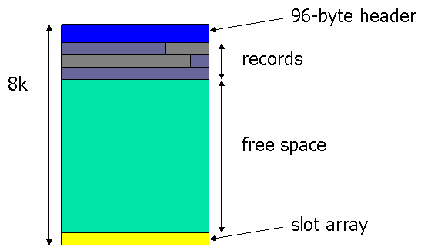
What a data page looks like
A data page is 8,192 bytes in size
The page header is 96 bytes
There is a slot array at the end of the page
All the rest is space for rows
https://www.sqlskills.com/blogs/paul/inside-the-storage-engine-anatomy-of-a-page/

Slide 14

Walkthrough
DECODING a SQL SERVER data FILE with a hex EDITOR

Slide 15
Looking at a data page with a hex editor
Data pages are aligned on an 8,192-byte boundary
If you’re looking at a data page (as opposed to, say, a GAM page), you can see the actual rows
So how do you know if it’s a data page?
Spoiler: the page type is in the page header
https://www.sqlskills.com/blogs/paul/inside-the-storage-engine-anatomy-of-a-page/

Slide 16
Looking at a data page header (first 96 bytes)
Yup, that’s a data page alright…
https://www.sqlskills.com/blogs/paul/inside-the-storage-engine-anatomy-of-a-page/

Slide 17
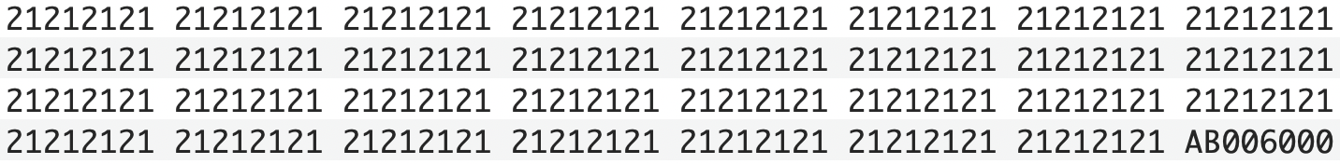
Looking at a slot array (end of the page)
0x0060 == offset 96 bytes from start of data page
0x00AB == offset 171 bytes from start of data page
https://www.sqlskills.com/blogs/paul/inside-the-storage-engine-anatomy-of-a-page/

Slide 18
The structure of a data row (1/2)
Byte 0 (TagA): Record type, a reversed bit mask
Byte 1 (TagB): 0x00 or 0x01 (ghost forwarded record only)
Bytes 2 – 3: Null bitmap offset
Then: Fixed-length portion
Followed by: Count of columns
Sources:
https://www.sqlskills.com/blogs/paul/inside-the-storage-engine-anatomy-of-a-record/
https://sqlundercover.com/2018/01/15/dissecting-sql-server-the-internal-structure-of-a-row/

Slide 19
The structure of a data row (2/2)
You’ll arrive at: The null bitmap (1 bit per column)
Next two bytes: Count of variable length columns
Then: two bytes per variable column with the end offset
Finally: Some variable column data!
Finally_1.docx: 14 bytes of row version data! (maybe)
Sources:
https://www.sqlskills.com/blogs/paul/inside-the-storage-engine-anatomy-of-a-record/
https://sqlundercover.com/2018/01/15/dissecting-sql-server-the-internal-structure-of-a-row/

Slide 20
TagA (the first byte of the row header)
The first byte is a bit mask
For example: 0x70 == 01110000
 | 0 | 1 | 2 | 3 | 4 | 5 | 6 | 7
Stored | 0 | 1 | 1 | 1 | 0 | 0 | 0 | 0
Actual | 0 | 0 | 0 | 0 | 1 | 1 | 1 | 0
 | ? | Page Type |  |  | NB | VL | RV | ?
NB: contains a null bitmap
VL: contains variable length column(s)
RV: contains row versioning (e.g., RCSI)
?: only Beyoncé knows
Sources:
https://www.sqlskills.com/blogs/paul/inside-the-storage-engine-anatomy-of-a-record/
https://sqlundercover.com/2018/01/15/dissecting-sql-server-the-internal-structure-of-a-row/

Slide 21
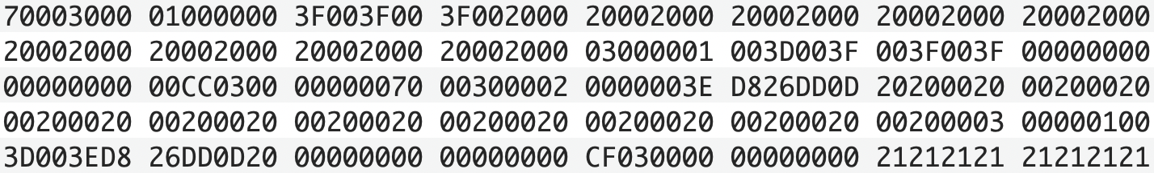
Viewing two rows of data in hexadecimal
According to the slot array:
0x0060 == first row starts
0x00AB == second row starts

Slide 22
The null bitmap offset (bytes 2-3 in the row header)
0x0030 == offset of fixed length end is at 48 bytes
0x00 == no nullable columns in here

Slide 23
Getting the column count (including variable-length columns)
0x03 == three columns in total
0x01 == one variable-length column

Slide 24
Getting the variable-length column offset
0x003D == offset 61 bytes to the end of the column

Slide 25
The fixed-length portion of the row (or, everything before the column count)
01000000 3F003F00 3F002000 20002000
20002000 20002000 20002000 20002000
20002000 20002000 20002000

Slide 26
The fixed-length portion of the row (the first column – let’s guess)
01000000 3F003F00 3F002000 20002000
20002000 20002000 20002000 20002000
20002000 20002000 20002000

Slide 27
The fixed-length portion of the row (the first column – let’s guess)
01000000 3F003F00 3F002000 20002000
20002000 20002000 20002000 20002000
20002000 20002000 20002000
Looks like an INT identity column
Notes:
We’re taking a wild guess here because we just don’t know for sure, but people following design standards will usually start a row with an auto-numbered INT.

Slide 28
The fixed-length portion of the row (the second column – let’s guess)
01000000 3F003F00 3F002000 20002000
20002000 20002000 20002000 20002000
20002000 20002000 20002000

Slide 29
The fixed-length portion of the row (the second column – let’s guess)
01000000 3F003F00 3F002000 20002000
20002000 20002000 20002000 20002000
20002000 20002000 20002000
Hint: 0x20 is a blank space in ASCII

Slide 30
The fixed-length portion of the row (the second column – let’s guess)
01000000 3F003F00 3F002000 20002000
20002000 20002000 20002000 20002000
20002000 20002000 20002000
Looks like an NCHAR(20) column
Notes:
We know from the null bitmap that there are three columns in this table, so the next 40 bytes all belong to the second column.

Slide 31
The variable-length portion of the row (the third column – let’s guess)
70003000 01000000 3F003F00 3F002000
20002000 20002000 20002000 20002000
20002000 20002000 20002000 20002000
03000001 003D003F 003F003F 00000000
00000000 00CC0300 000000
Notes:
This is where things start to get complicated. What if I told you there was a simpler way?

Slide 32
The variable-length portion of the row (the third column – let’s guess)
70003000 01000000 3F003F00 3F002000
20002000 20002000 20002000 20002000
20002000 20002000 20002000 20002000
03000001 003D003F 003F003F 00000000
00000000 00CC0300 000000
Hint: remember the bit in the TagA byte was true for versioning?

Slide 33
The variable-length portion of the row (the third column – let’s guess)
70003000 01000000 3F003F00 3F002000
20002000 20002000 20002000 20002000
20002000 20002000 20002000 20002000
03000001 003D003F 003F003F 00000000
00000000 00CC0300 000000
14 bytes needed for the versioning information
Notes:
This is where things start to get complicated. What if I told you there was a simpler way?

Slide 34
There’s a better way …
Notes:
This is where things start to get complicated. What if I told you there was a simpler way?

Slide 35
The funny thing about using a hex editor
It’s useful for disaster recovery
We just want to see how data types are persisted, so it’s not necessary
DBCC PAGE does all the heavy lifting for you

Slide 36
Using DBCC PAGE (1/2)
You need to know the data file and the page ID
You need to enable trace flag 3604
The easiest way to get the page ID is using DBCC IND
Or sys.dm_db_database_page_allocations, sure

Slide 37
Using DBCC PAGE (2/2)
DBCC TRACEON (3604);
DBCC IND ('database', 'table', -1);
DBCC PAGE (database, fileID, pageID, 3);
* -1 provides all index information about this table. You can use -1, 0, 1, or the actual NC index number
* 3 provides the page header, plus detailed information about each row
https://www.sqlskills.com/blogs/paul/inside-the-storage-engine-using-dbcc-page- and-dbcc-ind-to-find-out-if-page-splits-ever-roll-back/

Slide 38
Character strings
CHAR, NCHAR, VARCHAR, NVARCHAR

Slide 39
A-B-C: Always Be Collatin’
Collation, Unicode, and UTF-8 are terrifying
Microsoft used wacky code pages in the past
Collation affects not only sort-order, but storage as well
A column width is measured in bytes or byte-pairs
creative
https://docs.microsoft.com/sql/t-sql/data-types/nchar-and-nvarchar-transact-sql

Slide 40
After all that stuff about collation …
Strings are stored as-is on disk
No byte reversals here, nope
Always check your collation
Always use N'' for UTF-16 and UTF-8 strings
XML is NVARCHAR(MAX) with some optimizations

Slide 41
Numbers (exact & approximate)
TINYINT, SMALLINT, INT, BIGINT, MONEY, SMALLMONEY DECIMAL and NUMERIC, FLOAT, REAL

Slide 42
Integers
TINYINT (1), SMALLINT (2), INT (4), BIGINT (8)
Integers are signed integers, except TINYINT
Values are byte-reversed
SMALLMONEY and MONEY are stored as INT and BIGINT

Slide 43
Fixed-precision numeric / decimal
DECIMAL is the same as NUMERIC
Uses precision (total number of digits to store)
Uses scale (total number of decimal places)
The scale is the incrementing value*
Does not use two’s complement (0x01 for positive values)
* For example, if the scale is 4, each value will increment by 0.0001

Slide 44
For example, 4513.19 as DECIMAL
Precision and scale | Database storage | CAST AS VARBINARY
DECIMAL(19,4) | 0x017CA8B00200000000 | 0x130400017CA8B002
DECIMAL(15,2) | 0x01F7E2060000000000 | 0x0F020001F7E20600
DECIMAL(10,4) | 0x017CA8B00200000000 | 0x0A0400017CA8B002
DECIMAL(17,6) | 0x0170D0010D01000000 | 0x1106000170D0010D01000000
The leading 0x01 is the sign

Slide 45
Approximate numerics
FLOAT (and REAL) is a floating-point data type
Stores the closest approximation of the amount as a binary fraction
Does not use two’s complement (0 for positive values)
Great for exponents, terrible for financials

Slide 46
How SQL Server stores a floating-point value
4513.19 is stored as 0x3D0AD7A330A1B140
0x40B is translated into 0 10000001011
0 is the signed bit, and 10000001011 is the exponent
The exponent is offset against a bias, which is a fixed power of 2 (1023 for FLOAT, and 127 for REAL)

Slide 47
Floating points, continued (1/2)
The exponent is a power of 2, thus 2^1035
We subtract the bias of 2^1023, and end up with 2^12
To get from 4096 to 4513.19, we need to look at the significand, or mantissa

Slide 48
Floating points, continued (2/2)
The significand is 1.000110100001001100001010 0011110101110000101000111101
Notice the repeating pattern
If we multiply this all out, we get 4513.1899999999995998223312199115776
The 1 before the decimal point in the significand is a hidden bit, and never stored in the value
Notes:
The repeating pattern is why floating points can never store an accurate value. It will always store the closest approximation of the decimal value, as a binary fraction.

Slide 49
Dates and times
DATETIME, SMALLDATETIME, DATE, TIME, DATETIME2, DATETIMEOFFSET

Slide 50
Dates and times in SQL Server
DATETIME – original to Sybase (pre-Microsoft)
DATE, TIME, DATETIME2 – new to SQL Server 2008
DATETIMEOFFSET – William Assaf loves this one
SMALLDATETIME – don’t bother*
* Maybe we have time for the demo

Slide 51
Let’s talk about the date in DATETIME
Eight bytes wide, and not byte-swapped
First four bytes are the date, starting on 1900-01-01
Uses two’s complement for dates prior to 1900
Earliest value is 1753 because of the calendar change

Slide 52
Let’s talk about the time in DATETIME
Last four bytes are the time, rounded to 0, 3, or 7 ms
As Jeff Moden explains, it’s 1/300th of a second
3.3 ms is rounded down to 0.003
6.6 ms is rounded up to 0.007
0x00000002 = 00:00:00.007 (7 milliseconds past midnight)
https://www.sqlservercentral.com/articles/calculating-duration-using-datetime-start-and-end-dates-sql-spackle-2

Slide 53
Let’s talk about DATE
Three bytes wide
Byte-reversed
Number of days since 0001-01-01
Max value is 9999-12-31
Max value is stored as 0xDAB937, or 3,652,058 days

Slide 54
Let’s talk about TIME
Between three and five bytes wide
Precision stores 0 to 7 decimal fractions of a second
TIME(7) has a scale of 100 nanoseconds, which is ten million possible values in a single second
Maybe you don’t actually need to store that granularity

Slide 55
Let’s talk about DATETIME2
Smushes DATE and TIME together
Completely byte-swapped
Between 6 and 8 bytes wide (3 for DATE, 3-5 for TIME)
DATETIME2(3) is a drop-in replacement for DATETIME and will save you one byte per column per row*
* Uncompressed, rowstore

Slide 56
For example: 2020-04-22 10:05:09.3427651
Date | Stored value | Date in binary | Time in binary
DATETIME2(7) | 0xC3050E8A5400410B | 0x0B4100 - 737,536 | 0x548A0E05C3 - 363,093,427,651
DATETIME2(6) | 0x2D9A34740800410B | 0x0B4100 - 737,536 | 0x0874349A2D - 36,309,342,765
DATETIME2(5) | 0x05A96BD80000410B | 0x0B4100 - 737,536 | 0x00D86BA905 - 3,630,934,277
DATETIME2(4) | 0xB45DA41500410B | 0x0B4100 - 737,536 | 0x15A45DB4 - 363,093,428
DATETIME2(3) | 0x5F092A0200410B | 0x0B4100 - 737,536 | 0x022A095F - 36,309,343
DATETIME2(2) | 0x56673700410B | 0x0B4100 - 737,536 | 0x376756 - 3,630,934
DATETIME2(1) | 0x558A0500410B | 0x0B4100 - 737,536 | 0x058A55 - 363,093
DATETIME2(0) | 0xD58D0000410B | 0x0B4100 - 737,536 | 0x008DD5 - 36,309

Slide 57
Let’s talk about DATETIMEOFFSET
Smushes DATE and TIME together, and adds two bytes
Still completely byte-swapped
All times stored as UTC!
The last two bytes are the UTC offset in minutes
The offset uses two’s complement!
* Up to 14 hours (840 minutes)

Slide 58
GUIDs
UNIQUEIDENTIFIER

Slide 59
Globally unique identifiers (1/2)
Universally unique identifier (UUID)
128-bit value (16 bytes)
Unique* across multiple environments and timespans
Generated without needing a central repository
Don’t use GUIDs as strings – that would require 36 or 72 bytes per GUID
* in theory

Slide 60
Globally unique identifiers (2/2)
Designed to generate 10,000,000 identifiers* per second
Sort order is ... interesting
Six segments separated by hyphens
Two segments are combined into one
* per system

Slide 61
CC05E271-BACF-4472-901C-957568484405
Segment | Value | Size
time-low | CC05E271 | 4 bytes
time-mid | BACF | 2 bytes
time-high-and-version | 4472 | 2 bytes
clock-seq-and-reserved | 90 | 1 byte
clock-seq-low | 1C | 1 byte
node | 957568484405 | 6 bytes

Slide 62
CC05E271-BACF-4472-901C-957568484405
Segment | Value | Storage
time-low | CC05E271 | 0x71E205CC
time-mid | BACF | 0xCFBA
time-high-and-version | 4472 | 0x7244
clock-seq-and-reserved | 90 | 0x90
clock-seq-low | 1C | 0x1C
node | 957568484405 | 0x957568484405
Why is the node not byte-reversed?
It’s the MAC address – kind of – and therefore the sort order!

Slide 63
Bonus round
SQL_VARIANT and BIT

Slide 64
SQL_VARIANT is a chimera
Stores strings, integers, and binary
Strings can be stored as ASCII or UTF-16
Not fully ODBC compatible: you might get binary back

Slide 65
SQL_VARIANT continued (1/2)
Each value has a prefix indicating its type
Character prefix includes the actual collation
The integer prefix includes a version which is always 1

Slide 66
SQL_VARIANT continued (2/2)
N'Randolph' is encoded as 0xE701401F08C00000 520061006E0064006F006C0070006800
0xE7 (system type 231) indicates NVARCHAR
The rest is decoded by using SQL_VARIANT_PROPERTY, and includes collation, precision, scale, and total bytes

Slide 67
Let’s finish with the BIT
One byte for 1-8 columns of type BIT, and so on
Byte-reversed
Each position in the bitmask is the true/false value

